Slide 1
Additional Pricing Correlations
Slides 21 – 52 are from Peters and Timmerhaus, 3rd edition
These charts do not appear in the 4th or 5th editions, but the authors assume you will go back and acess them as needed.
These charts are from January 1979 and are scaled to the present date using the Chemical Engineering Price Indices.

Slide 2
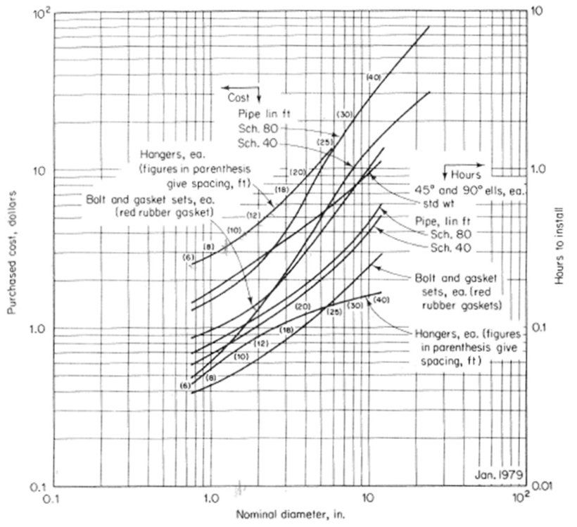
These curves read to the left.
These curves read to the right.
Figure 13-3. Cost and installation time for carbon-steel welded pipe and fittings.

Slide 3
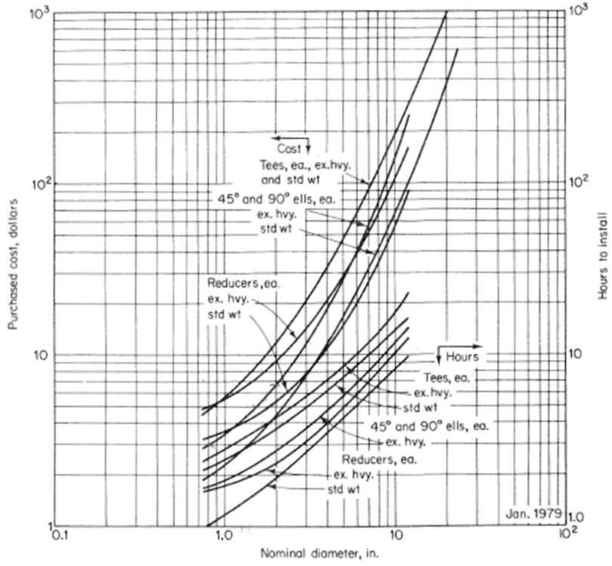

These curves read to the left.
These curves read to the right.
Figure 13-3. Cost and installation time for carbon-steel welded pipe and fittings.

Slide 4
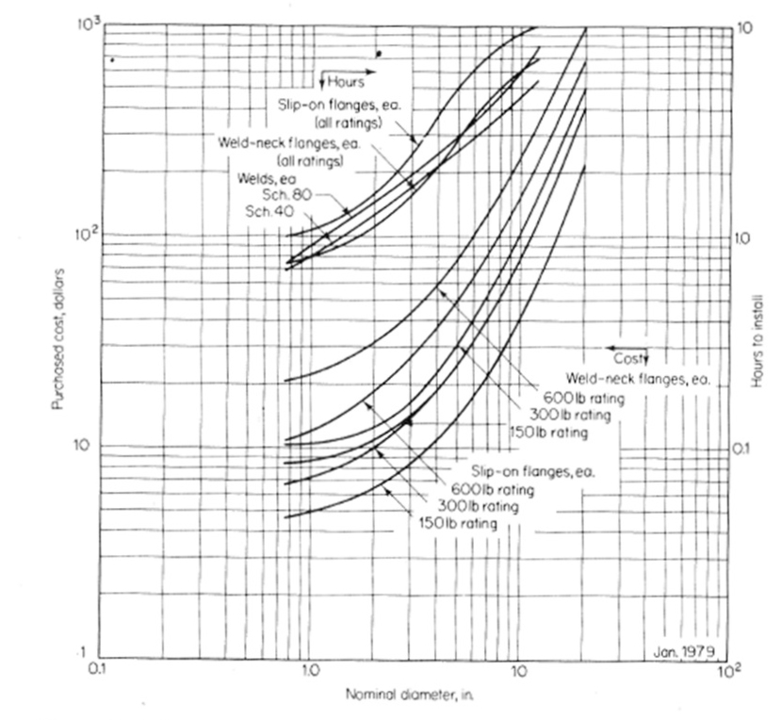
Figure 13-5. Cost and installation time for carbon-steel welded pipe and fittings.

Slide 5
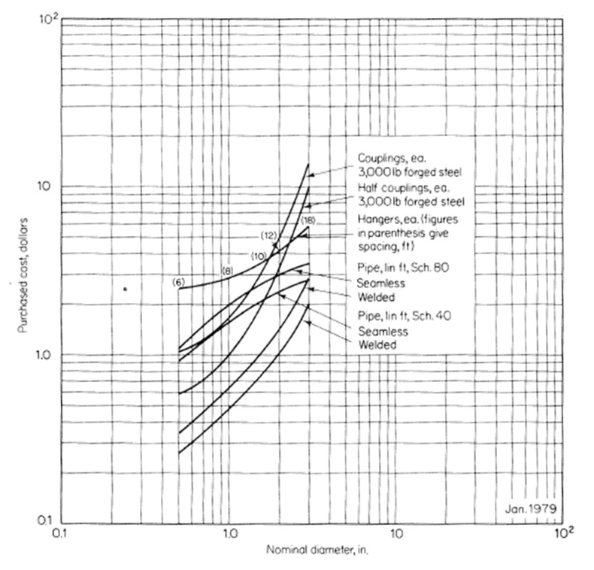
Figure 13-6. Cost of carbon-steel screwed pipe and fittings.

Slide 6
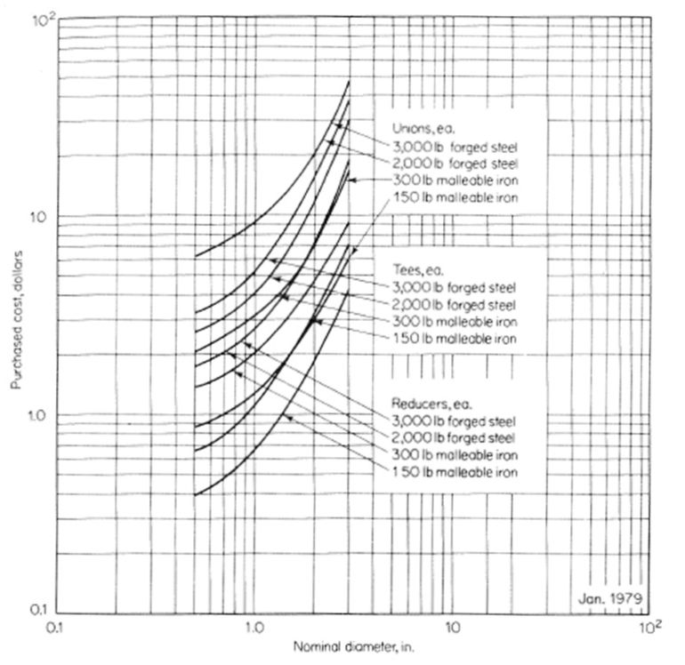
Figure 13-7. Cost of carbon-steel screwed pipe and fittings.

Slide 7
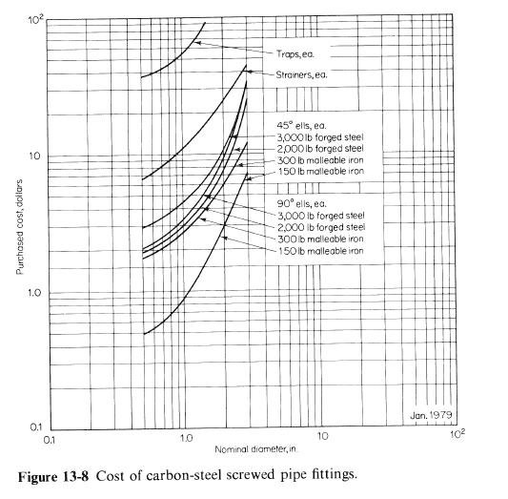

Slide 8
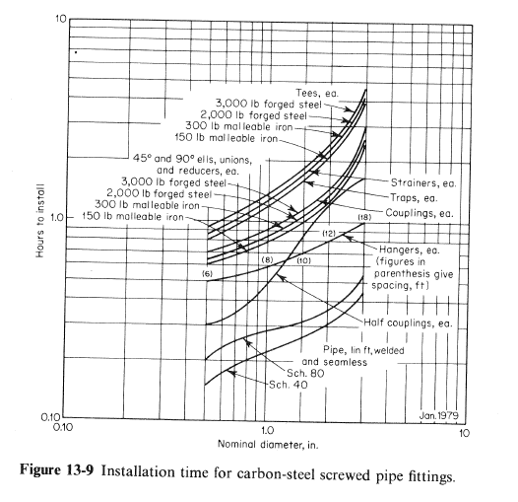

Slide 9
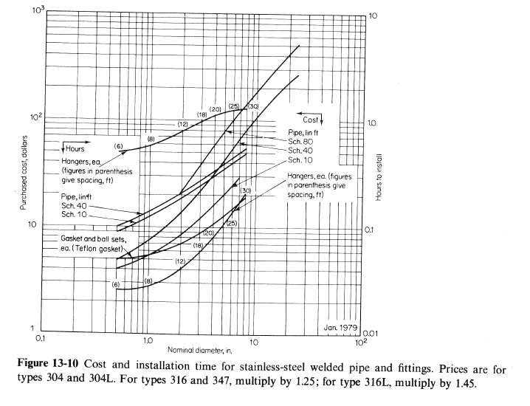

Slide 10
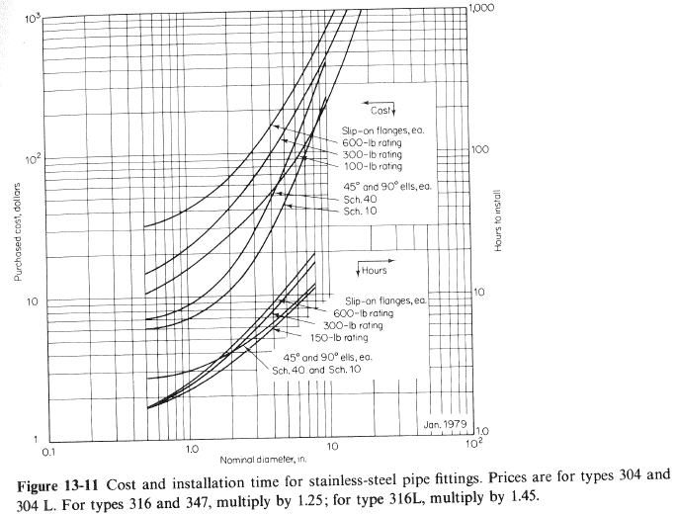

Slide 11
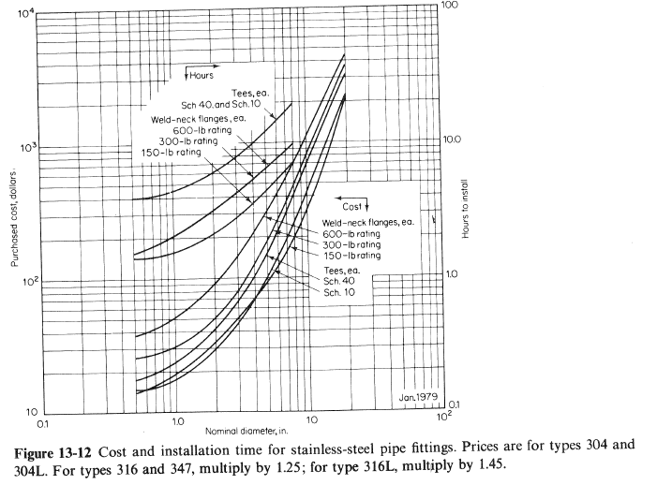

Slide 12
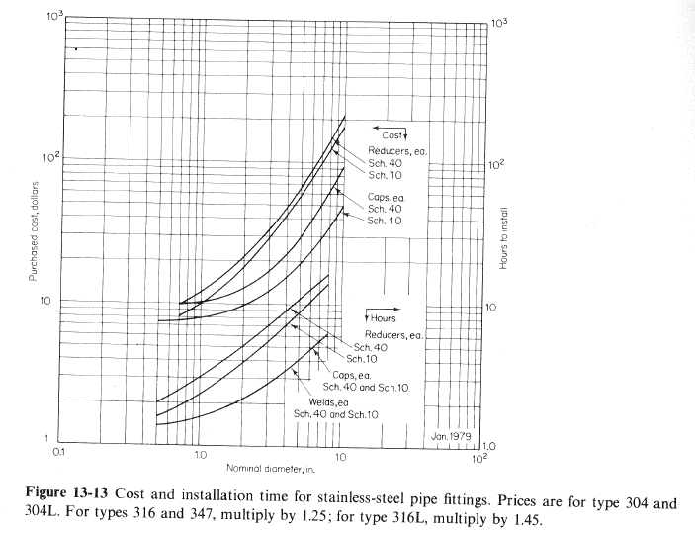

Slide 13
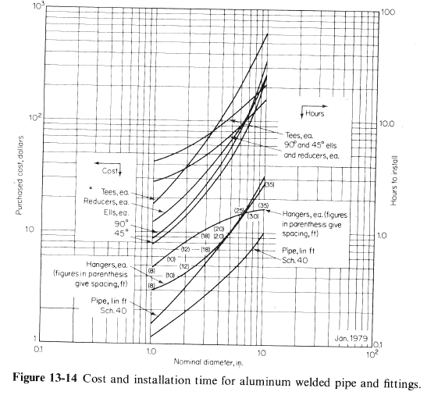

Slide 14
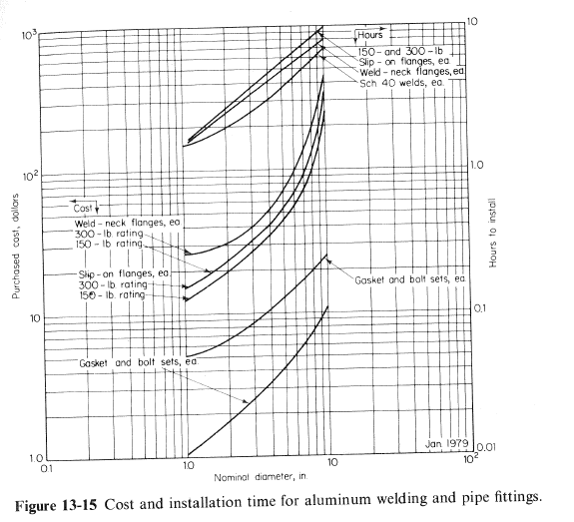

Slide 15
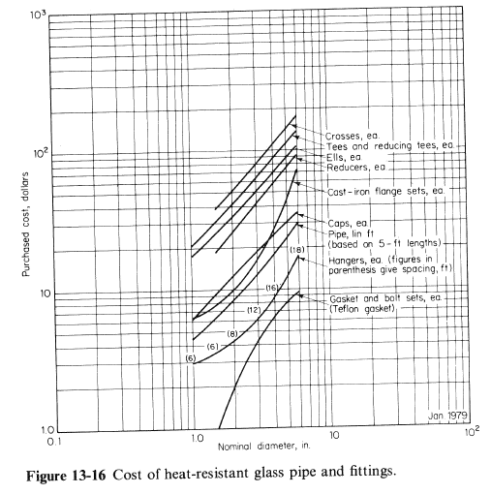

Slide 16
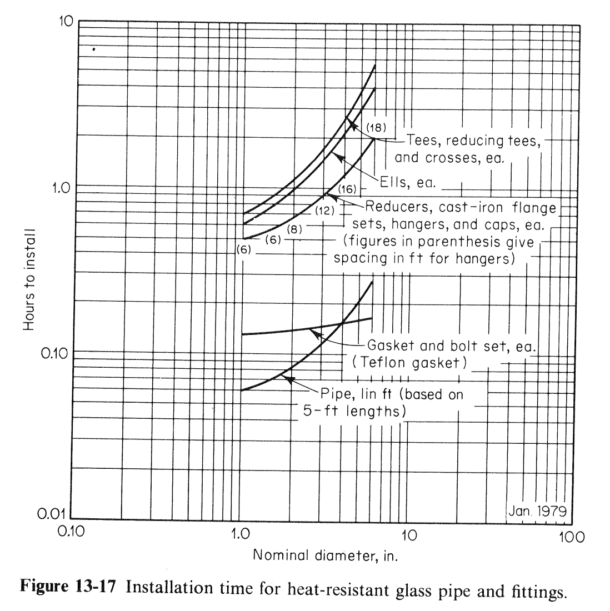

Slide 17
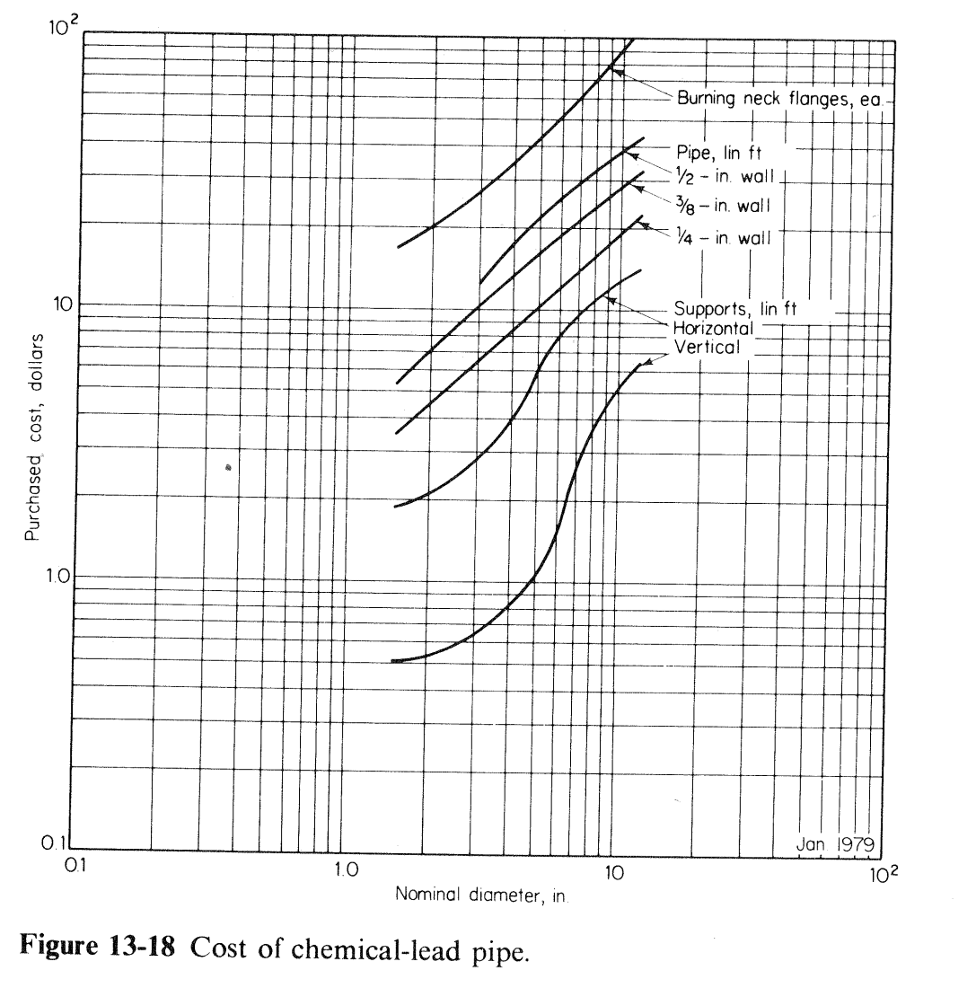

Slide 18
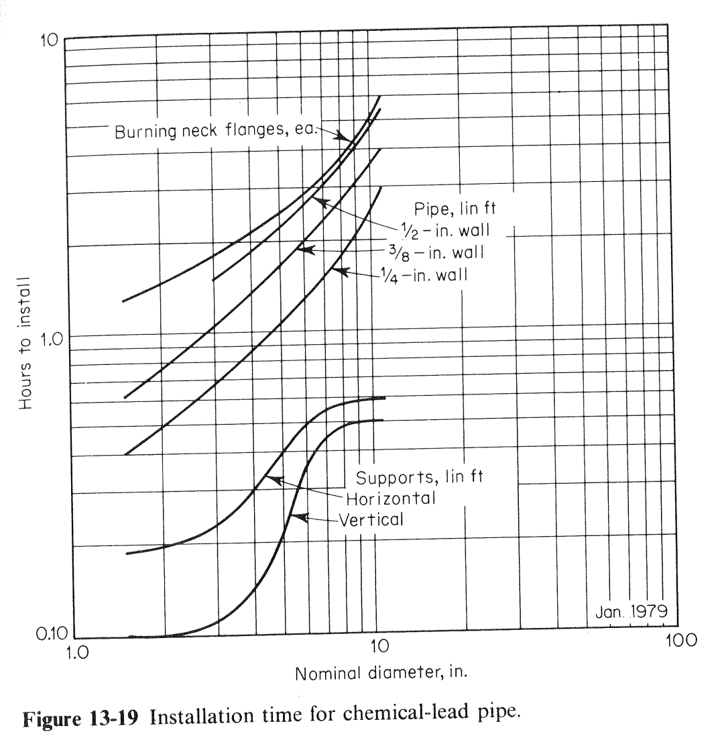

Slide 19
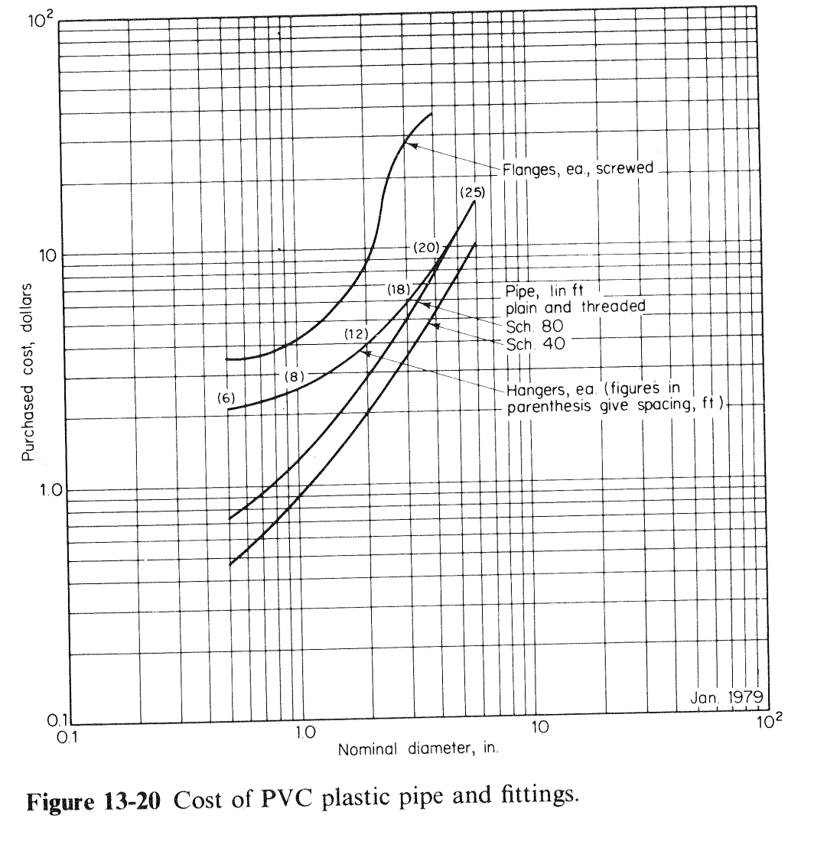

Slide 20
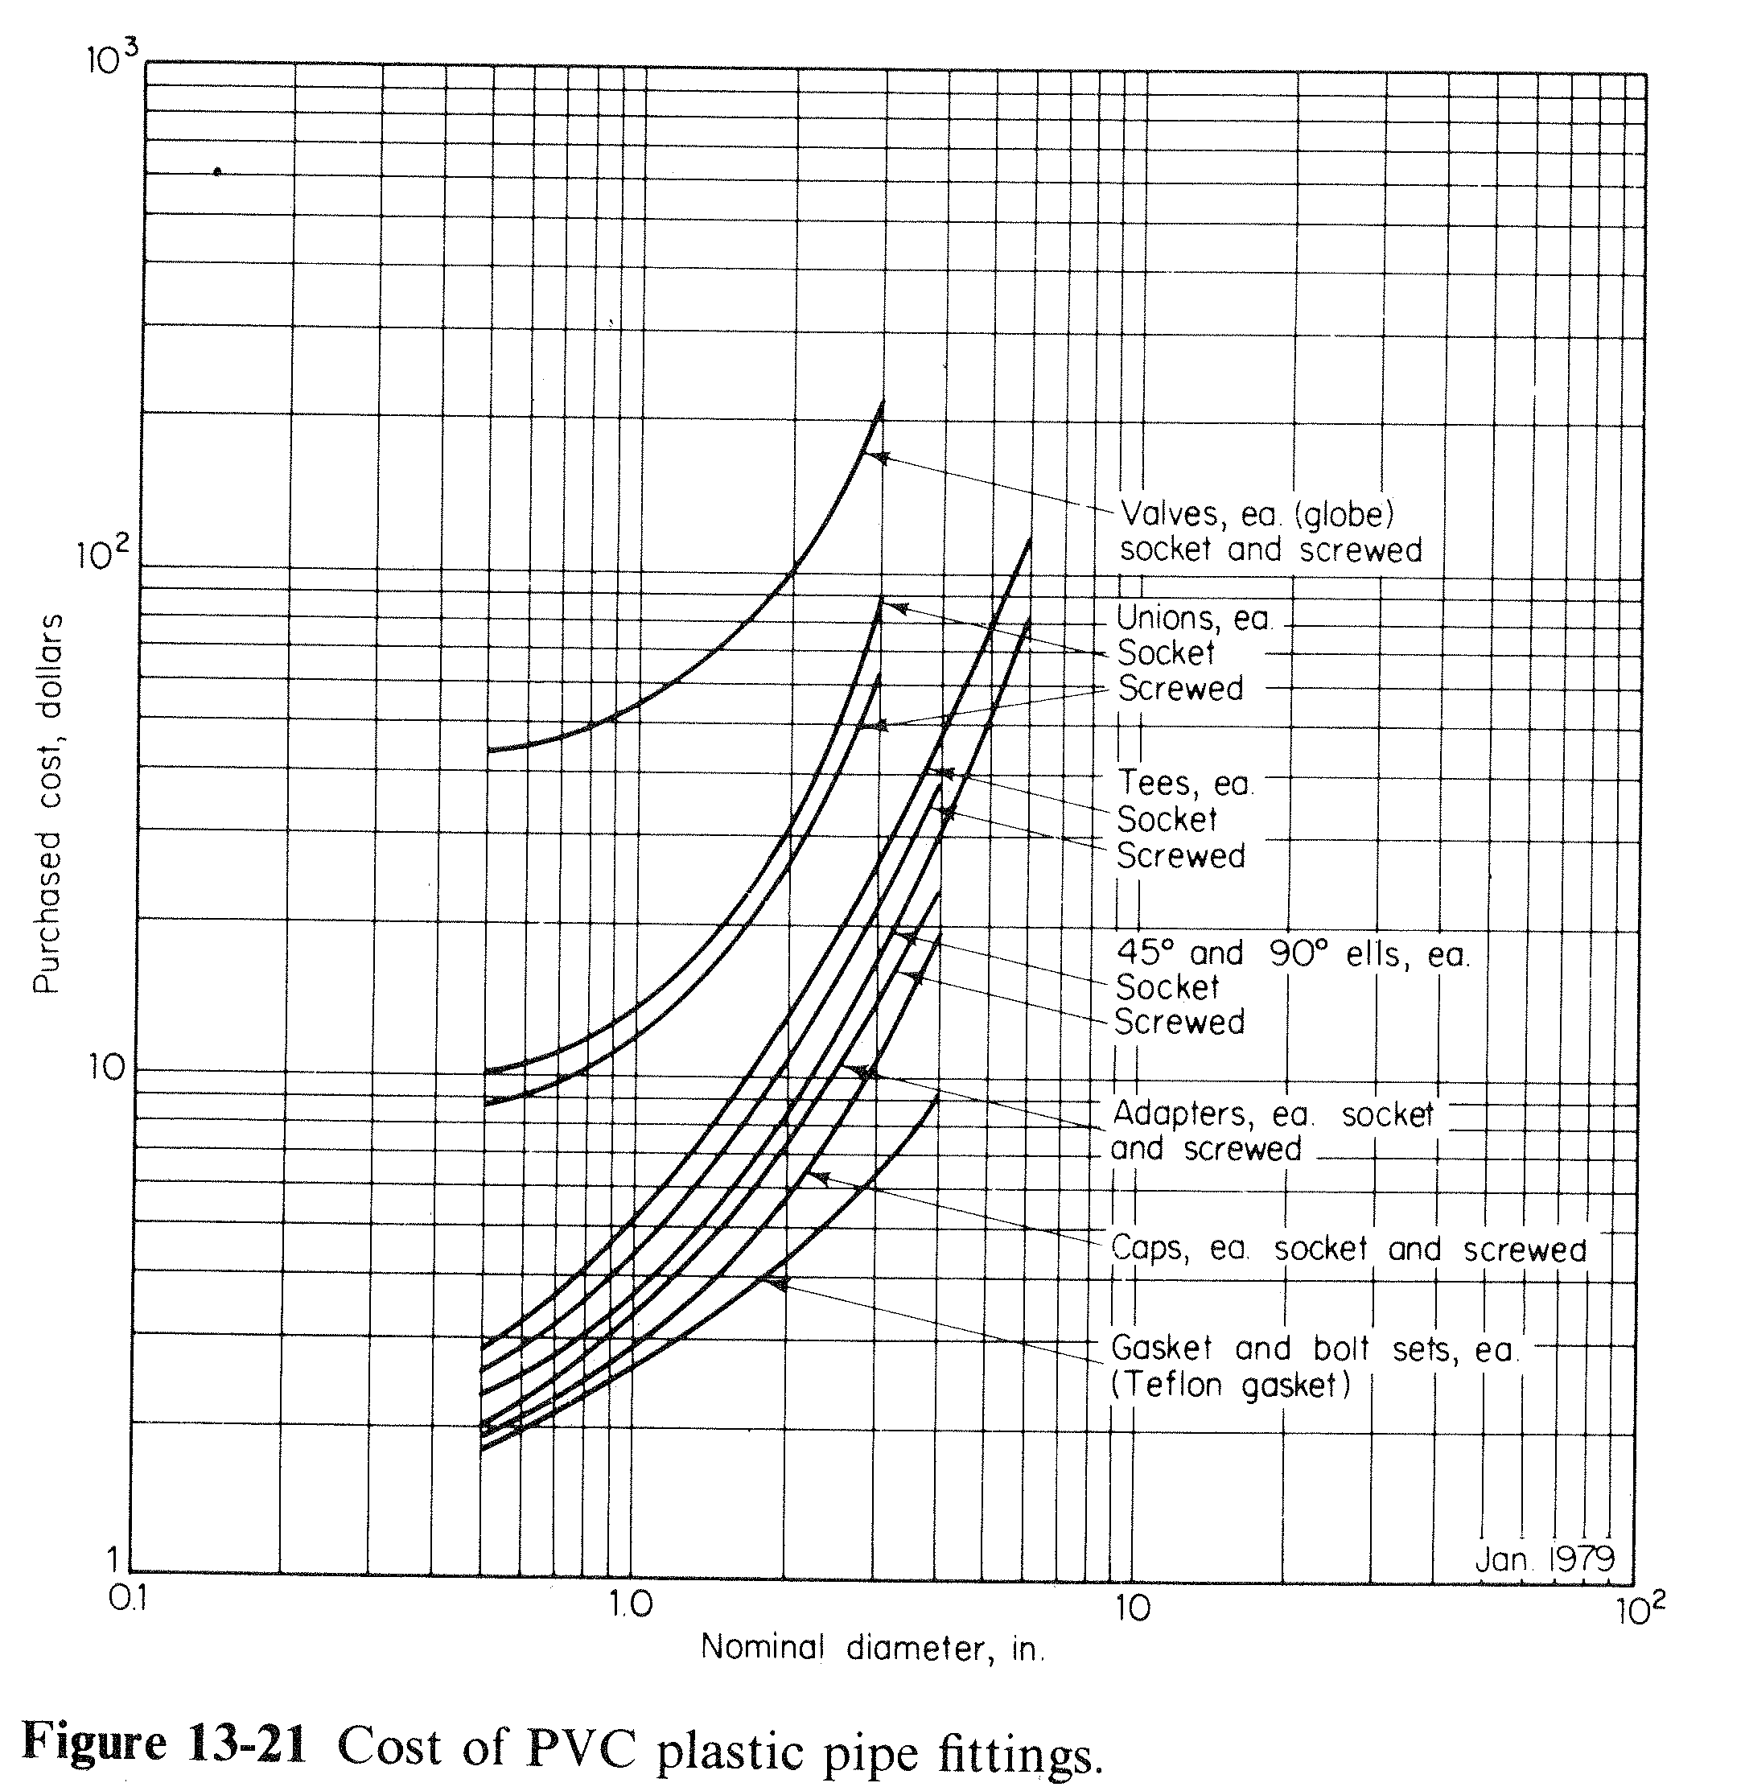

Slide 21
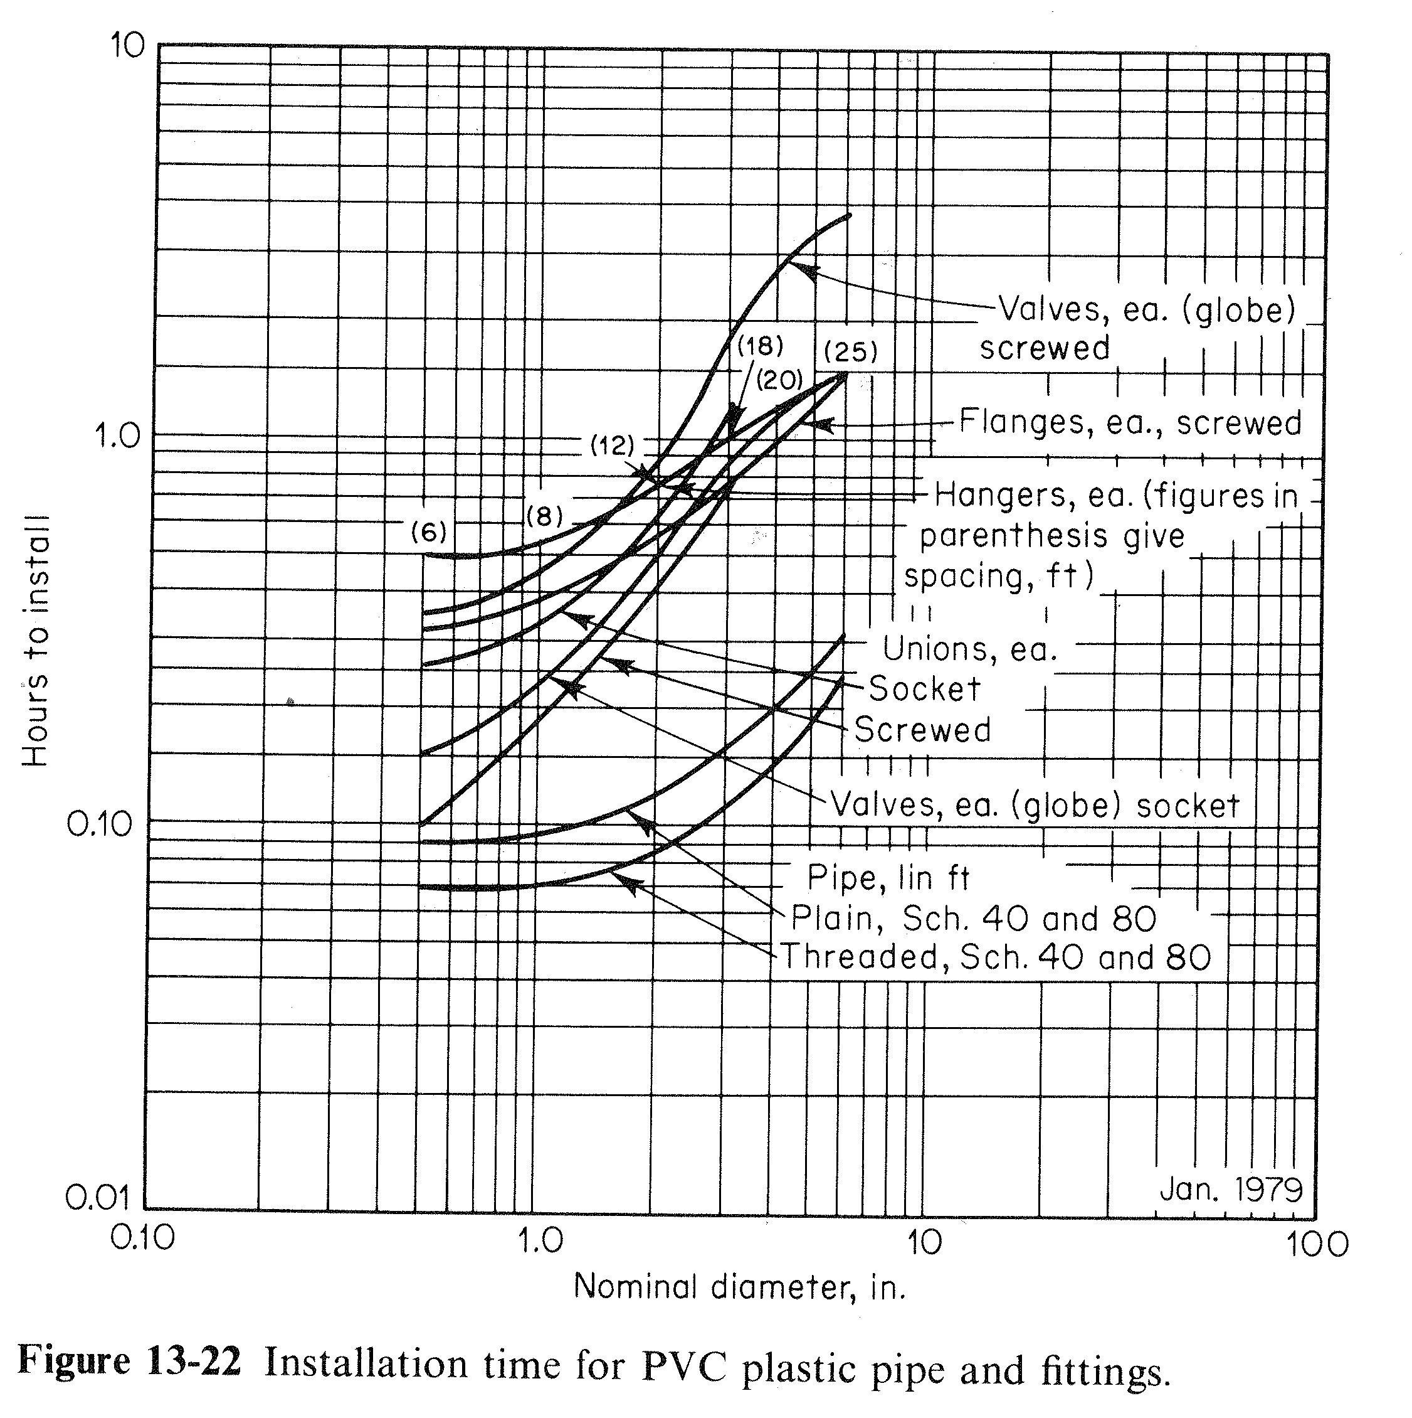

Slide 22
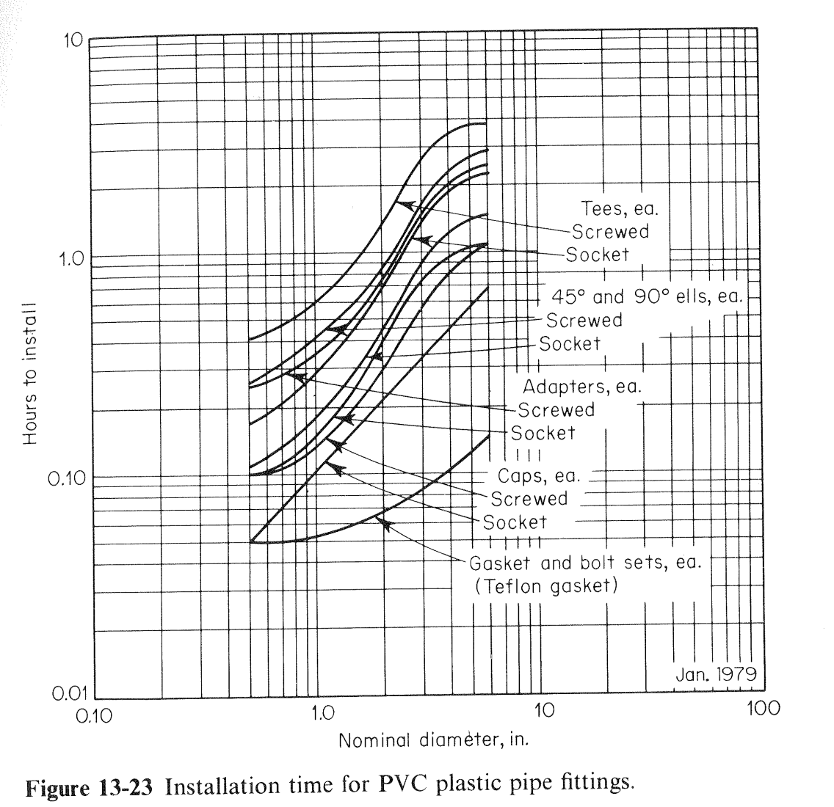

Slide 23
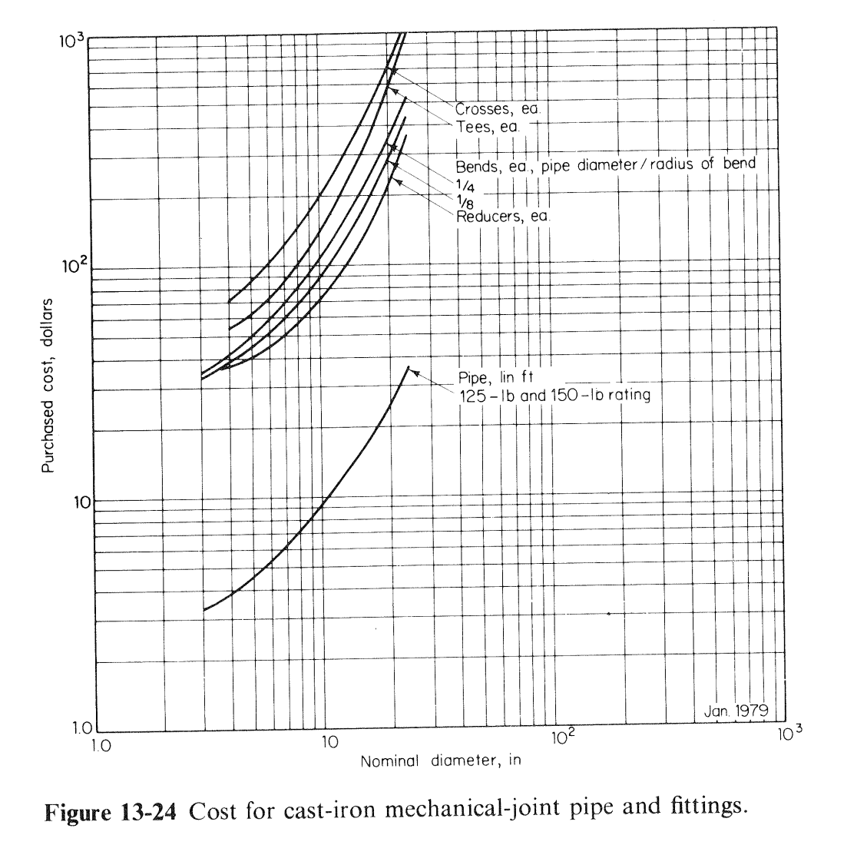

Slide 24
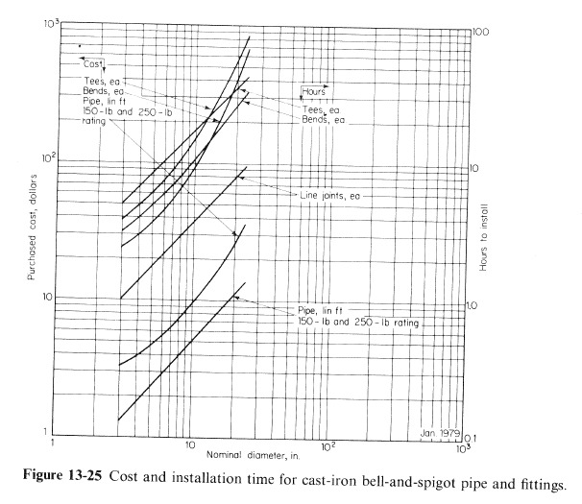

Slide 25
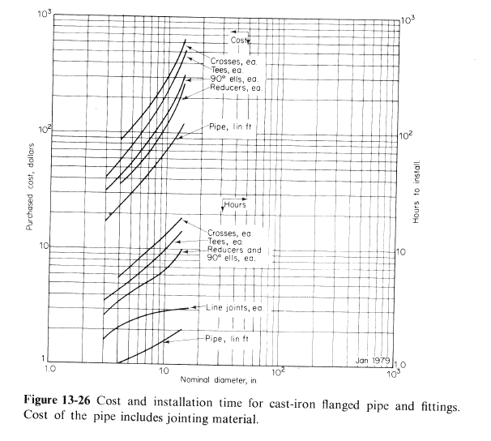

Slide 26
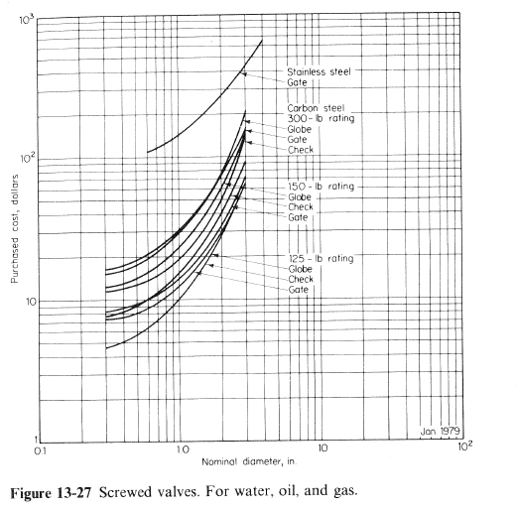

Slide 27
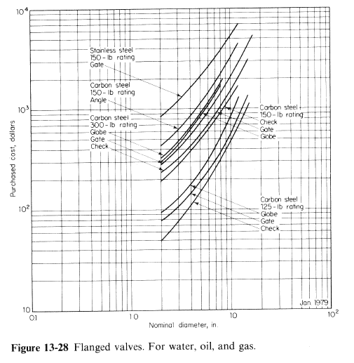

Slide 28
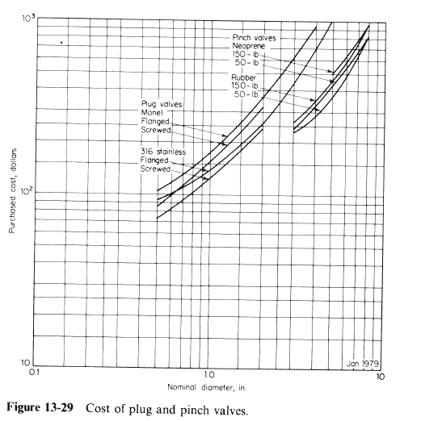

Slide 29
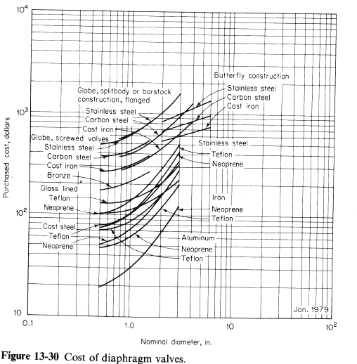

Slide 30
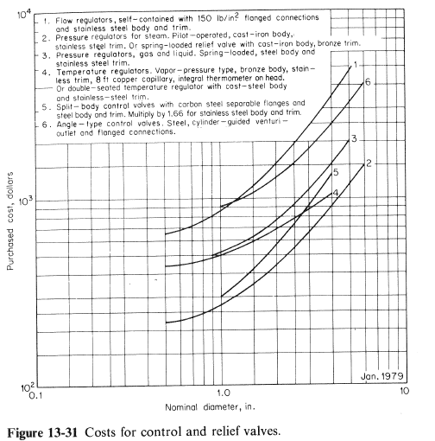

Slide 31
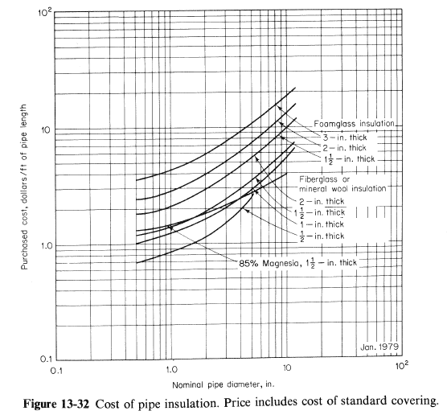

Slide 32
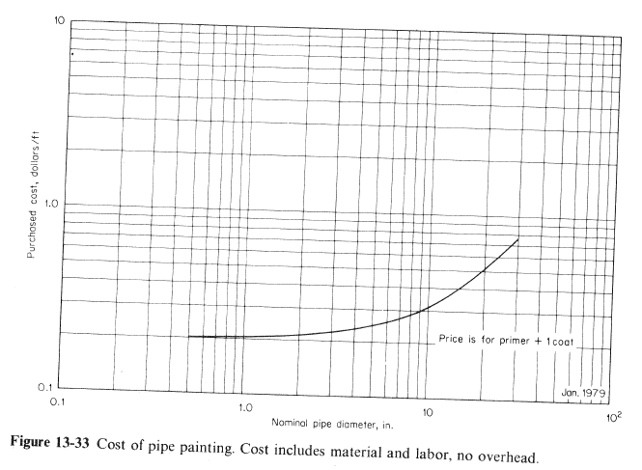

Slide 33
